Slide 1

Final project- SIIT 8
Elena-Luiza BÎLTEANU

Slide 2
Summary
Why Școala Informală de IT?
Why Java?
My project
Project choice
Functionalities
Structure
Technologies used
Conclusions

Slide 3

Why Școala Informală de IT?
Making a change
Challenge
Problem solving thinking

Slide 4
Why Java?
Object Oriented Programming language;
Huge amount of documentation available;
”Write once, run anywhere” – a Java program can be developed on any device.

Slide 5



















Daily planner

Slide 6
Functionalities
Create/Edit/Delete lists;
Create/Edit/Delete tasks;
Add the tasks to lists;
Display the tasks from a specific list.

Slide 7

Homepage

Slide 8
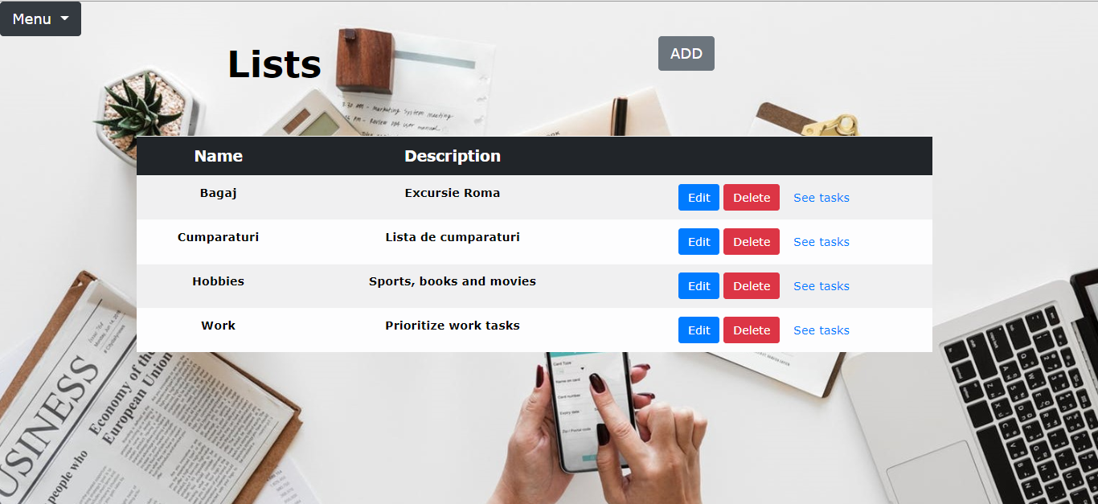
Lists

Slide 9
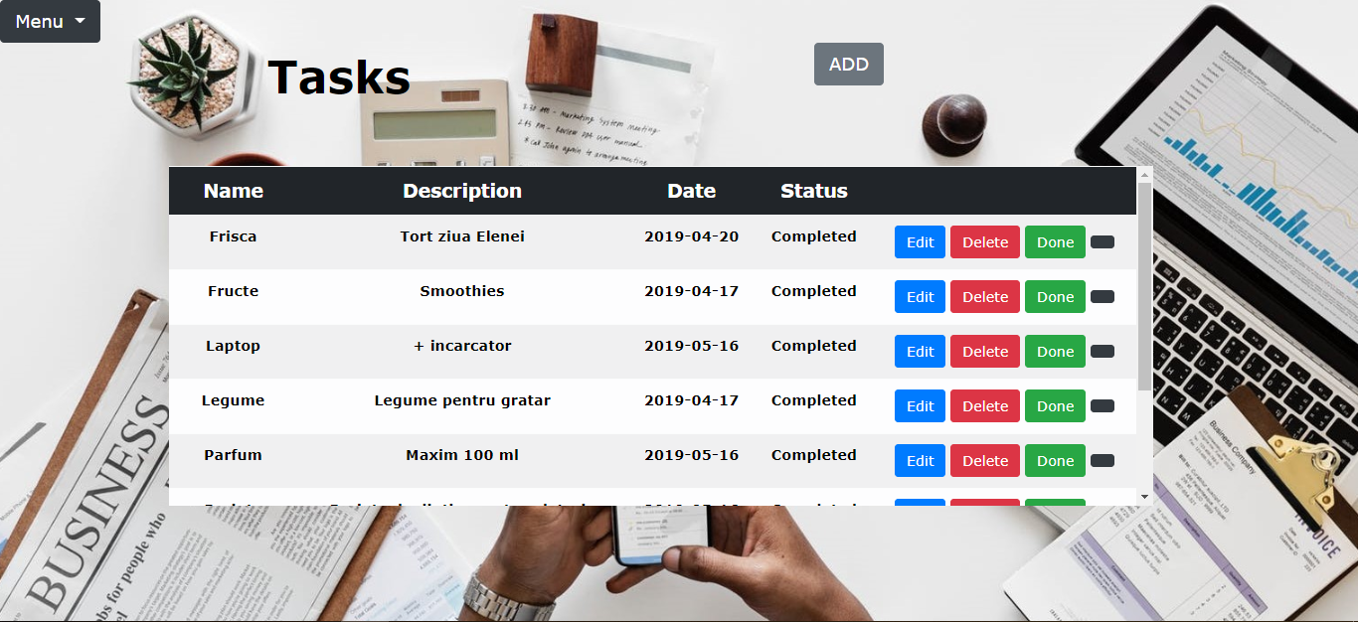
Tasks

Slide 10
Technologies used
Java
- JDBC (Java Data Base Connectivity)
- Java Servlet
- JSP (Java Server Pages)
Web container: Tomcat
HTML
CSS
JavaScript
Bootstrap
PostgreSQL

Slide 11

Web page basic structure
Enhanced by CSS and JavaScript
The core of the web page

Slide 12
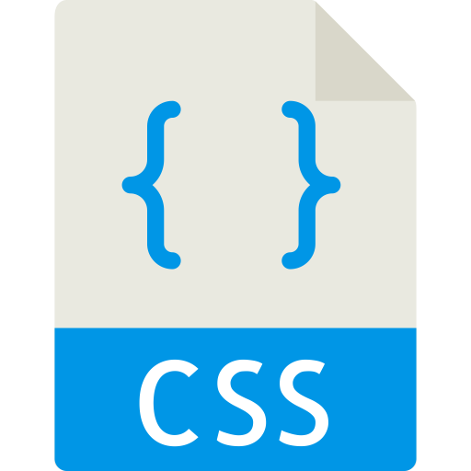
Styles the HTML content
Controls:
presentation
formatting
layout

Slide 13

Controls the behavior
Functionality
Calls-to-action
Makes it interactive

Slide 14
Git Hub
https://github.com/LuizaBilteanu/dailyPlanner2

Slide 15
Conclusions
Don’t give up on the first try. Keep going.
Be patient. Trust yourself.
Don’t get overwhelmed when making mistakes.
Not trying is also failure.

Slide 16
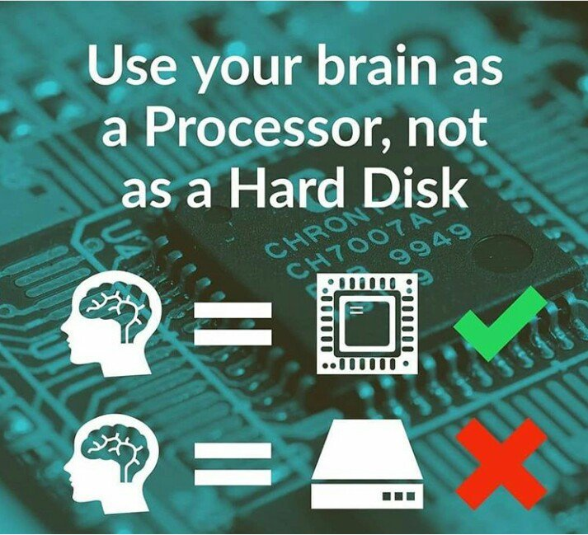

Slide 17

Thank you for your attention!

